Slide 1
D9 Trainer Matrix 2023/2024
REVIEW
& UPDATE
A guide to completion

Slide 2
Why do we need to complete a Trainer Matrix?
Completion of a Trainer Matrix allows LSV to demonstrate that as an RTO, we are adhering to our requirements under Standard 1 of the Standards for RTOs 2015 and, in particular, Clauses 1.13 to 1.16
In simple terms, as a TAF, you must:
Hold a current Training and Assessment Qualification as outlined in the standards
TAE40122
TAE40116
TAE40110 plus TAELLN411 or TAELLN401A and TAEASS502A or TAEASS502B
TAESS00001 or TAESS00011 (Assessors Only)
TAESS00007 or TAESS00014 or BSBCMM411 and TAEDEL301(Trainer under supervision)
Hold the units of competency at least to the level being delivered
Have industry skills directly relevant to the training and assessment provided
Have current knowledge and skills in vocational training and learning that informs their training and assessment

Slide 3
Who Needs to complete a D9 Matrix?
The D9 Matrix is only required if you are going to deliver the following courses
Resuscitation (CPR)
HLTAID009 – Provide Cardiopulmonary Resuscitation
First Aid (FA)
HLTAID009 – Provide Cardiopulmonary Resuscitation
HLTAID010 – Provide Basic Emergency Care
HLTAID011 – Provide First Aid
Advanced Resuscitation Techniques (ART)*
HLTAID009 - Provide Cardiopulmonary Resuscitation
HLTAID015 – Provide Advanced Resuscitation Techniques and oxygen therapy
Advanced Resuscitation Techniques & First Aid (ARTFA)*
HLTAID009 – Provide Cardiopulmonary Resuscitation
HLTAID010 – Provide Basic Emergency Care
HLTAID011 – Provide First Aid
HLTAID015 – Provide Advanced Resuscitation Techniques and oxygen therapy
* Must hold pre-requisite of HLTAID011

Slide 4
What does this look like?
Possess vocational competence
Maintain current industry skills
Directly relevant to the training and assessment provided
Have current knowledge and skills
In vocational training and learning that informs training and assessment
Undertake ongoing professional development in
Knowledge and practice of vocational training
Learning and assessment, including competency-based assessment
At LSV – this means holding the qualifications you are delivering
At least to the level they train and assess
Working within the industry is the gold standard, and is required for some units of competency but this can also include keeping abreast of changes within the industry, new equipment, etc.

Slide 5
What has changed?
Following an internal audit, it has been identified that the D9 form needed to provide more evidence of professional development, vocational currency and several minor points. To address these issues, the following changes have been applied.
Acknowledgment of review of current RTO Policies
Reduction of Skills Experience and Industry Currency to last three years
Clearer format to capture Professional Development in VET/Training and Assessment
VET/Training and Assessment Professional Development Plan
The Training under Supervision (for those holding TOC only) section has been expanded to capture regular periodic supervision meetings to demonstrate sufficient evidence to meet the Standards for RTOs

Slide 6
INSTRUCTIONS FOR COMPLETION
HINTS

Slide 7
INSTRUCTIONS FOR COMPLETION
Which sections do I need to complete?
TAFs
COMPLETE
ORANGE SECTIONS
LSV QA STAFF
COMPLETE
GREEN SECTIONS
Look out through this presentation for the below boxes in the footer for tips on completing your D9 Matrix!
SUPPORT AVAILABLE
COMMONLY MISSED SECTION
ACTION MAY BE REQUIRED
Contact the QA Team for support or guidance
Trainermatrix@lsv.com.au
Qualityteam@lsv.com.au
This section was missed and held up approval for a number of Trainers in 2022/2023
Additional action may be required for some Trainers

Slide 8
TAF DETAILS & - SECTION 1- TRAINING AND ASSESSMENT/VOCATIONAL QUALIFICATIONS
PAGE
1

Slide 9
Trainer Details
First Name
Surname
Email Address
Phone Number
Third Party Provider

Slide 10
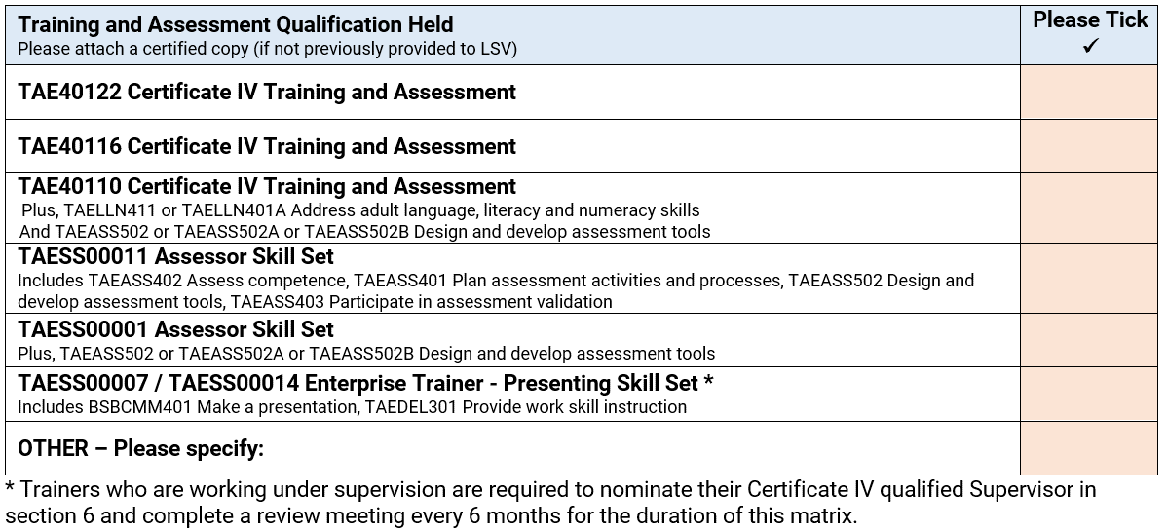
Section 1: Training and Assessment / Vocational Qualifications
NEW OPTION INCLUDED
**Note** If it is a new qualification or you are a new trainer, please provide the documents to us.
Tick which Qualification you hold.
If you hold multiple qualifications, tick the most recent, or highest level (for example, if you held the TAE40110 plus 2 units but have recently updated to the TAE40116, tick the TAE40116)
If you have previously provided us with a copy of your Testamur and Record of Results for the above, these do not need to be provided again.

Slide 11
Section 1: Training and Assessment / Vocational Qualifications
Provide us with details of your Working with Children Card/VIT Registration and a copy of your card:
If providing VIT registration, please ensure you have registered it with the WWCC. Steps to do this can be found here:
https://service.vic.gov.au/services/teachers-notifications/
If the card has been provided previously and is still current, this does not need to be provided.
Annual RTO Policy Review
RTO Policies need to be reviewed annually. RTO Policies can be found in the Resource Library in aXcelerate or on the LSV website
https://lsv.com.au/compliance-policies-3/
COMMONLY MISSED SECTION

Slide 12
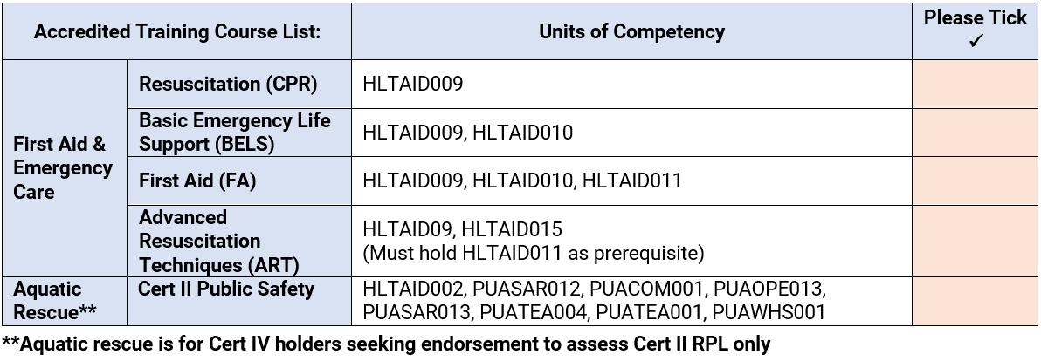
Section 1: Training and Assessment/Vocational Qualifications
Tick the course types/units of competency from the list you hold and are looking to deliver as a TAF.
If qualifications/statements of attainment are issued by another RTO, and you have not yet provided copies to VT, please do so as part of this.
**Note** You must hold a current HLTAID009 to deliver FA
You must hold a current HLTAID011 (including current HLTAID009) to deliver ART
ACTION MAY BE REQUIRED

Slide 13
Section 1: Training and Assessment / Vocational Qualifications
Onboarding of new Course Types
If you would like to add a course type to your deliverables, you will need to add this to your D9 Matrix before you can be signed off.
When considering what you may like to add, please ensure you have relevant work experience in the area or additional training and professional development, sufficient to demonstrate industry currency and any unit-specific requirements for the SIS Training Package.
ACTION MAY BE REQUIRED

Slide 14
- SECTION 2 - SKILLS, EXPERIENCE AND INDUSTRY CURRENCY
PAGE
2

Slide 15
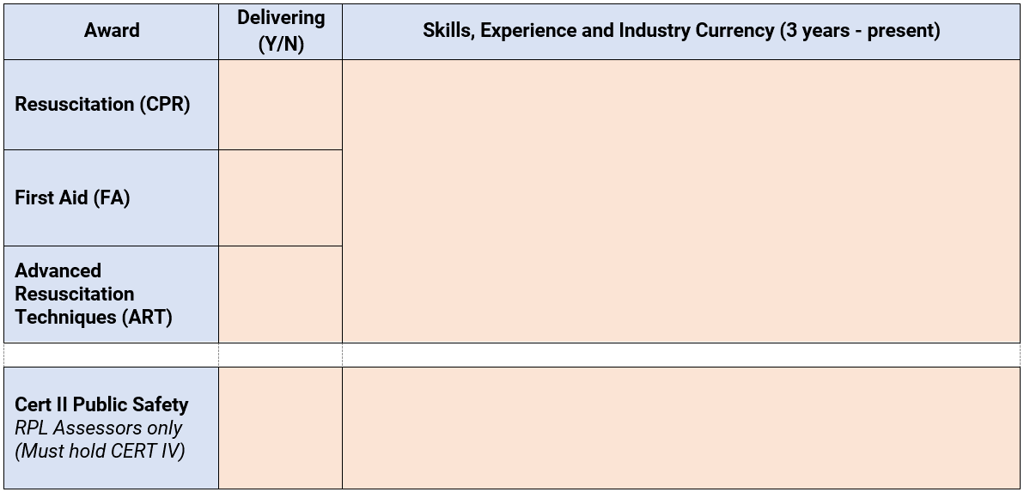
Section 2: Skills, Experience and Industry Currency
+
+
SKILL
EXPERIENCE
CURRENCY
The ability to do something that comes from training, experience, or practice
Knowledge or skill in a particular job or activity that you have gained because you have done that job or activity for a long time
Within the last 3 years for all courses.
=
INDUSTRY CURRENCY
Skills and experience applying the skills and knowledge being trained in an employment or volunteer situation.

Slide 16
Section 2: Skills, Experience and Industry Currency
FIRST AID
1. Managing teams of first aiders at events and on patrol. Responding to and treating various first aid related incidents. Maintaining and recording use of first aid equipment.
2. As a sports trainer, my role is to provide first aid for all injuries and first aid incidents for all training and matches involving all Senior teams. Injuries include soft tissue injures, fractures, dislocations, bleeding, concussion, teeth injuries.
POOL/SURF LIFEGUARD
1. In my role as a pool lifeguard I am responsible for the supervision of patrons across the different pools and features within the facility, conducting preventative actions and rescues.
2. As a volunteer lifesaver, I work as part of a team patrolling in an open water environment, assessing risks, supervising beach visitors and performing rescues and using oxygen and BVM where required. To maintain currency of my skills and knowledge in a pool environment I update my qualifications each year and attended events such as the Aquatic Industry Summit and Industry Masterclass on Supervision
SWIM TEACHER
1. In my role as a Swim Teacher I develop and adapt lesson plans focusing on water familiarisation, water safety and stroke development. I deliver lessons ranging in duration from 30-45 minutes to infants and children to both small groups and individuals.
2. As a School Teacher I am required , develop plans to structure skill development. I apply this knowledge to the delivery of swim lessons to primary school students as part of our water safety lessons within the PE curriculum.

Slide 17
Section 2: Skills, Experience and Industry Currency
Evidence to demonstrate industry currency might include:​
Letters from supervisors for employment activities, paid or volunteer
Documentation and letters from suppliers, clients and service providers ​
For details of the requirements of these roles, refer to
SOP 1.03 – Patrol Member Duties
SOP 8.03 – Water Safety Procedures
For a position description, refer to your original employment application or discuss it with your supervisor
Contact the QA team to discuss your options if you cannot provide evidence.
SUPPORT AVAILABLE

Slide 18
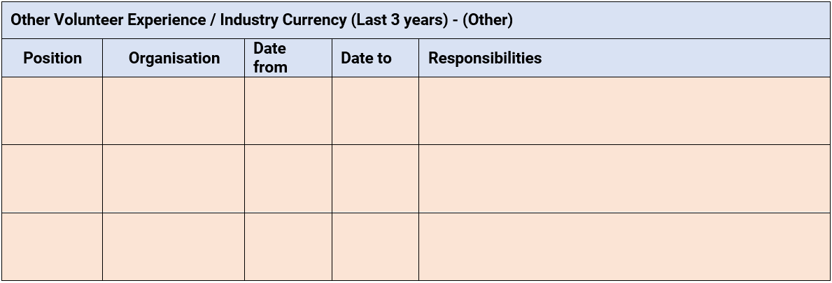
Section 2: Skills, Experience and Industry Currency
Evidence to demonstrate industry currency might include:​
Letters from supervisors for employment activities, paid or volunteer ​
Documentation and letters from suppliers, clients and service providers ​
We acknowledge not everyone has been an LSV Lifeguard, Sports Trainer/Water Safety or Patrolling Member but may have held other roles where they use the skills and knowledge they are training and assessing.
Use this table to tell us more about these other roles!
Contact the QA team to discuss your options if you cannot provide evidence.
SUPPORT AVAILABLE

Slide 19
- SECTION 3 - PROFESSIONAL DEVELOPMENT IN VET/TRAINING AND ASSESSMENT
PAGE
3

Slide 20
Section 3: Professional Development in VET/ Training and Assessment
WHAT IS VET PD
EVIDENCE OF COMPLETED PD
How have you stayed up-to-date with requirements in the VET sector?
How have you improved or developed your training style and skills?
Certificate of attendance/completion​
Meeting minutes along with agenda & presentations Receipt of payment – supported by copies of training materials or agenda​
Signed confirmation of attendance at a meeting or discussion developing skills and knowledge with summary of content
REQUIREMENTS PER YEAR
WHERE COULD I LOCATE WHAT I HAVE DONE?
Volunteer TAFs - 8 hours
What did you list in your 2022/2023 PD Plan?
Completed with LSV?
Completed with VELG? Check Velg for invoices and certificates!

Slide 21
Section 3: Professional Development in VET / Training and Assessment
WHERE CAN I FIND RELEVANT PROFESSIONAL DEVELOPMENT?
LSV maintains a Corporate Membership with Velg Training, which allows our TAFs to request a sibling membership.
Velg Training - https://www.velgtraining.com/ -
Members Lunchbox Webinars - https://www.velgtraining.com/knowledge/topics/148
You will receive a certificate after completion.
Knowledge Hub - https://www.velgtraining.com/knowledge
Velg2Go - https://www.velgtraining.com/events/827/individual-courses-rpqtylb
If you haven’t already, contact the QA team to set up a Sibling Membership to get access to free and discounted PD opportunities. Any Velg PD completed will be recorded in your Velg profile which the QA team can access and will also make completing your matrix easier by listing what you have completed!
SUPPORT AVAILABLE

Slide 22
Section 3: Professional Development in VET/ Training and Assessment
WHERE ELSE CAN I FIND RELEVANT PROFESSIONAL DEVELOPMENT?
LSV Trainer and Assessor PD webpage - https://lsv.com.au/training-all/trainer-professional-development/
LSV Public Training Newsletter – Both industry and VET related PD opportunities are listed.
VET Development Centre - https://vdc.edu.au/
ASQA - https://www.asqa.gov.au/guidance-resources/resources-providers/videos-and-webinars
Skills Education - https://www.skillseducation.com.au/

Slide 23
Section 3: Professional Development in VET / Training and Assessment
What information do you need to provide us?
PD name/activity
Date Completed
Organisation
Duration (hours)
PD learnings – How does this PD improve your training/teaching practices?
We have provided space for at least four instances of PD you have completed. If you need additional space, feel free to submit more pages!

Slide 24
- SECTION 4 - VET/TRAINING AND ASSESSMENT PROFESSIONAL DEVELOPMENT PLAN
PAGE
4

Slide 25
Section 4: VET / Training and Assessment Professional Development Plan
Now you have told us what you have done, its time to look forward to the next 12 months!
We are looking for a plan to complete PD regularly to show ongoing development.
This will also help you complete your matrix for 2025/2027!
July to Sept
Oct to Dec
Jan -Mar
April - June
TAN 2024
We know it might be difficult to plan 12 months into the future, but this will help you plan out your PD so that you can spread it out across the year!

Slide 26
- SECTION 5 - TAF DECLARATION
PAGE
5

Slide 27
Section 5: Trainer Declaration
This section is simple to complete, however you would be surprised how many forms are returned to Trainers to complete the Declaration.
Whilst it may just look like your name and signature, what you are declaring to and providing us consent for is crucial to our ability to finalise your matrix.
Print your name here
Print the date here
Sign the document here using either electronic docu-sign, your electronic signature or print and sign this page and attach separately.
COMMONLY MISSED SECTION

Slide 28
- SECTION 6 - TRAINING UNDER SUPERVISION
PAGES
5 - 13

Slide 29
What is Training under Supervision?
Trainers who only hold a Training Officer Certificate (or equivalent) are required to operate under the supervision of a Certificate IV qualified person to meet the Standard 1 of the Standards for RTOs 2015 and, in particular, Clauses 1.17 to 1.20
LSV has determined that the level of supervision is a formally recorded meeting with your nominated supervisor every six months to discuss your training in that period
Your D9 has four copies of the supervision form, one for each period.
The form provides more detail about your activities than previously requested.
A checklist has been included to guide the meeting with your supervisor.
Upon completion of the supervision meeting, you need to submit your form (every six months)

Slide 30
Section 6: Training Under Supervision
Trainer Name - First name & surname
Supervisor Name – First name & surname
Date – Date meeting occurred
Location – Physical location, telephone, online

Slide 31
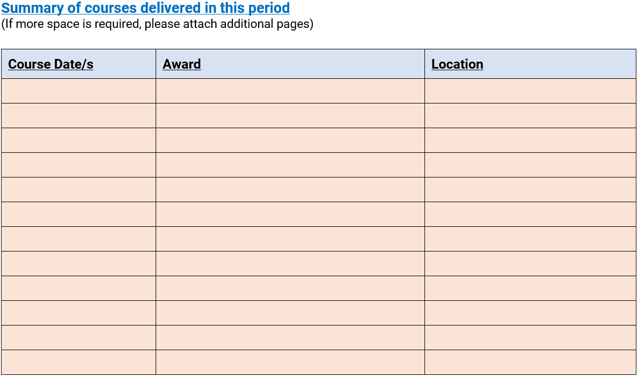
Section 6: Training Under Supervision
Provide a record of the courses you have delivered/assisted in delivering over the six-month period.
Only include accredited courses in this list
You can fill this section in after each course so you don’t miss any
If you need more space, attach another sheet.
ACTION MAY BE REQUIRED

Slide 32
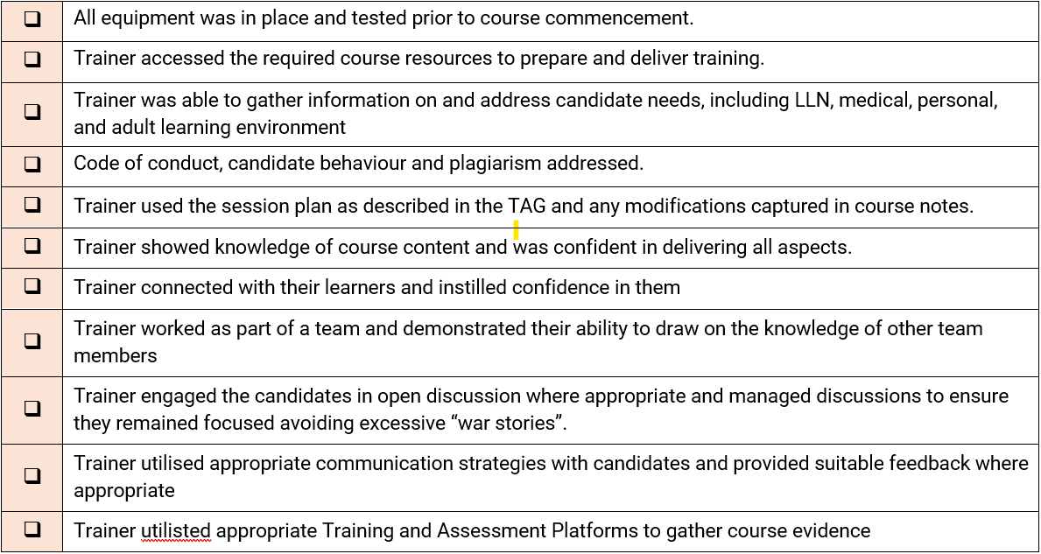
Section 6: Training Under Supervision
Your supervisor will use this checklist to ensure that they discuss all the required points during your meeting.
Don’t worry if your supervisor feels that they cannot check off one of the dot points. Use it to identify improvements in your delivery. You will be sure to check it off next meeting.
ACTION MAY BE REQUIRED

Slide 33
Section 6: Training Under Supervision
In this field, include any issues experienced during any of the courses listed at the start of the form. This should be a talking point in your supervision meeting.
Be honest. This helps you to identify ways you can improve your delivery and will in turn make you a better trainer.
ACTION MAY BE REQUIRED

Slide 34
Section 6: Training Under Supervision
In your supervision meeting, discuss any improvements you need to make or support you need to be able to be a better trainer
Be honest. This helps you to identify tools and methods you can use to improve your delivery and will, in turn, make you a better trainer.
ACTION MAY BE REQUIRED

Slide 35
Section 6: Training Under Supervision
Use this field if you need to capture any further detail or something not included elsewhere on the form.
ACTION MAY BE REQUIRED

Slide 36
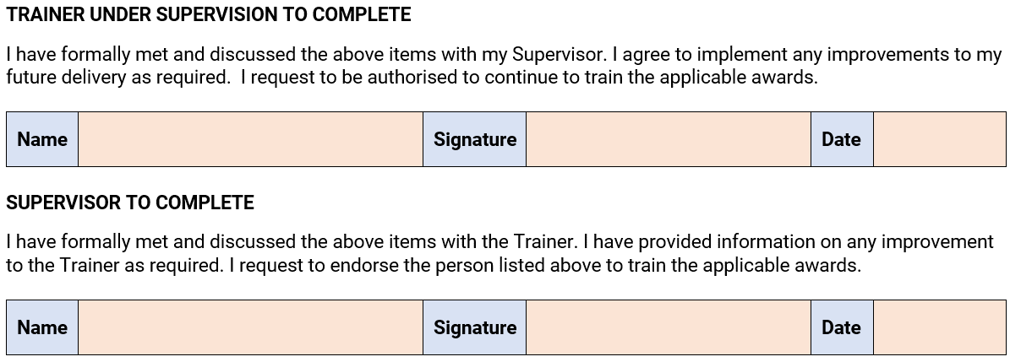
Section 6: Training Under Supervision
Print your name here
Print the date
Supervisor to print name here
Sign the document here using either electronic docu-sign, your electronic signature or print and sign this page and attach separately.
COMMONLY MISSED SECTION

Slide 37
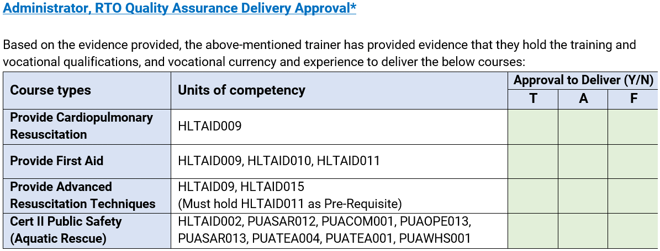
LSV Staff Sign Off
REMEMBER!
LSV QA STAFF
COMPLETE
GREEN SECTIONS
This section is to be completed by a member of the LSV Quality Assurance Team only.
This is how we track completion and sign off for your Matrix as well as the approvals for each trainer deliverables.

Slide 38
Have questions or need support?
When contacting the Quality Assurance team with regards to your matrix or compliance related items it is best to contact us at the below email addresses which are monitored regularly.
Trainer Matrix
trainermatrix@lsv.com.au
Submission of Matrix
Assistance with evidence
Questions relating to PD
Submission of Supervisor Meeting Forms
Quality Team
qualityteam@lsv.com.au
Requests for VELG Sibling Memberships
General RTO compliance queries
Kate Penney – Quality Assurance and Systems Lead Specialist

